Slide 1
Combinatorics
Mathematics PowerPoint
Group 6

Slide 2


Our Group
Fahruddin Zaim Ibrahim
Ichsan Ali Darmawan
2241720253
2241720077

Slide 3
Table of Contents
Introduction
Factorial
Permutations
Combinations
Probability
Exercises

Slide 4
01
Introduction

Slide 5
—Source: britannica.com
Combinatorics, also called combinatorial mathematics, the field of mathematics concerned with problems of selection, arrangement, and operation within a finite or discrete system. Included is the closely related area of combinatorial geometry.

Slide 6
What are the uses of Combinatorics?

Slide 7
Combinatorics has many applications in other areas of mathematics, including graph theory, coding and cryptography, and probability.

Slide 8
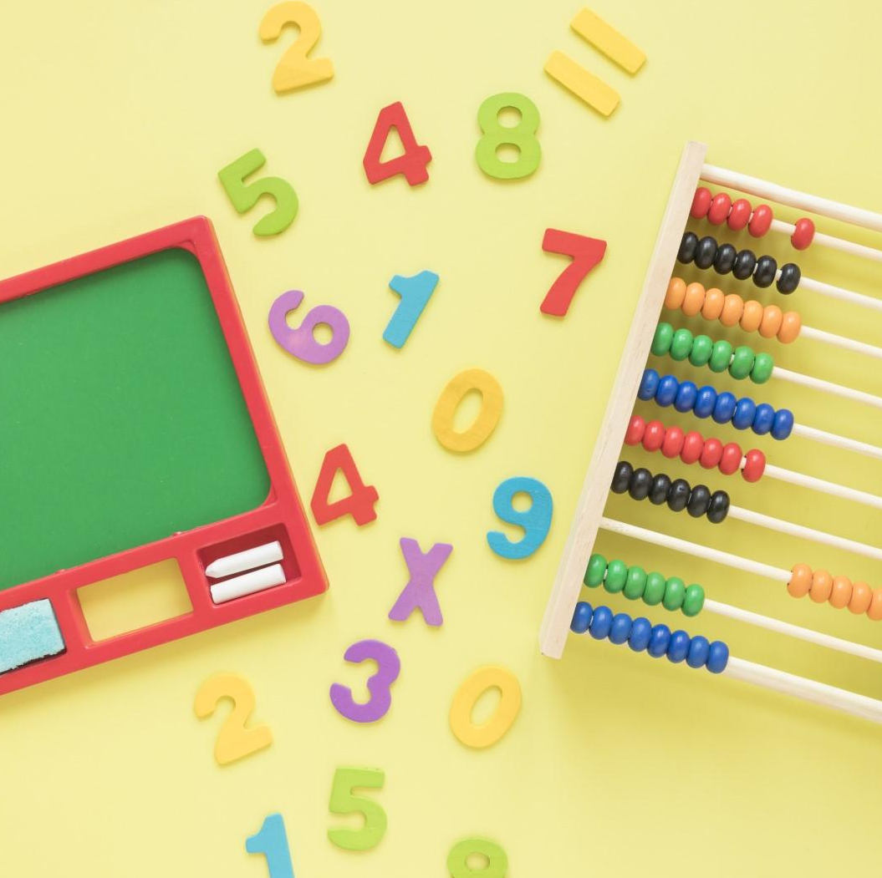
Combinatorics in Real Life
Combinatorics has many applications in probability theory. You often want to find the probability of one particular event and you can use the equation

Slide 9

Combinatorics in Computer Science
Combinatorics has an incredible amount of applications in Computer Science. The first and probably most important aspect is Graph Theory: The image is for a graph depicting the vertex and edges.

Slide 10
02
Factorial

Slide 11
What is Factorial?
The factorial formula is used in the calculation of permutations and combinations, which is obtained by taking the product of all numbers in the sequence (i.e., from 1 to n).

Slide 12
Example
In a classroom there are 3 student and 3 chairs standing in a row. In how many different orders can the pupils sit on these chairs?

Slide 13
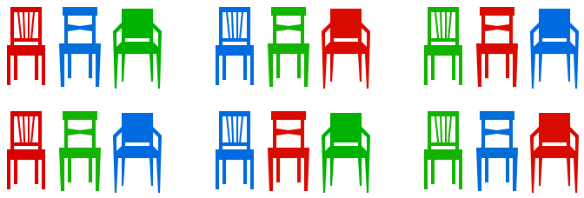
How to Solve It
Let us list the possibilities – in this example the 3 different students are represented by 3 different colours of the chairs.
There are 6 different possible orders. Notice that the number of possible orders increases very quickly as the number of pupils increases.

Slide 14
Formula
The formula for n factorial is n! = n × (n - 1)!.
For example, 5! (“five factorial”) is the same as 5 × 4 × 3 × 2 × 1. Above we have just shown that there are n! possibilities to order n objects.
5! =
5 × 4 × 3 × 2 × 1 = 120

Slide 15
03
Permutations

Slide 16
What is Permutations?
The term permutation refers to a mathematical calculation of the number of ways a particular set can be arranged. Put simply, a permutation is a word that describes the number of ways things can be ordered or arranged. With permutations, the order of the arrangement matters.

Slide 17
Example
How many different possibilities are there for any 2 of 3 Students to sit on 2 chairs? Note that 1 will be left standing, which we don’t have to include when listing the possibilities

Slide 18
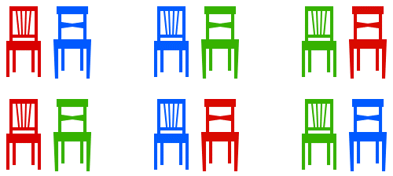
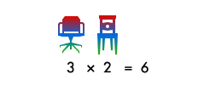
How to Solve It
Let us start again by listing all possibilities
To find a simple formula like the one above, we can think about it in a very similar way. undefined In total there are 6 possibilities

Slide 19



Formula
The formula for n permutations is nPr! = $\frac{n!}{\left(n−r\right)!}$
For example, What if we placing 7 students on 3 chairs, so there are 210 possibilities
7 × 6 × 5 = $\frac{\text{7 × 6 × 5 × 6 × }\text{4 }\text{× }\text{3}\text{ × }\text{2}\text{ ×}\text{ 1} }{\text{4}\text{ × }\text{3}\text{ × }\text{2} \text{× }\text{1} }$ = 210
$\frac{7!}{4!}$= $\frac{7!}{\left(7−3\right)!}$

Slide 20
04
Combinations

Slide 21
What is Combinations?
The combination formula is used to find the number of ways of selecting items from a collection, such that the order of selection does not matter. In simple words, combination involves the selection of objects or things out of a larger group where order doesn't matter.

Slide 22
Example
In a shop there are five different T-shirts you like, colored red, blue, green, yellow and black. Unfortunately you only have enough money to buy three of them. How many ways are there to select three T-shirts from the five you like?

Slide 23
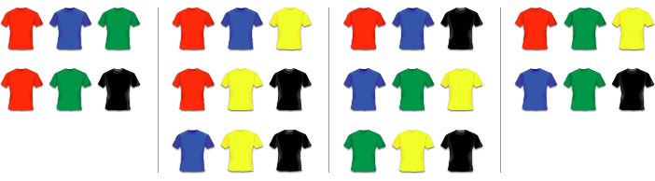
How to Solve It
Here we don’t care about the order (it doesn’t matter if we buy black first and then red or red first and then black), only about the number of combinations of T-shirts. The possibilities are 10 possibilities

Slide 24

How to solve it
With permutations, we count every combination of three T-shirts 6 times, because there are 3! = 6 ways to order the three T-shirts. To get the number of combinations from the number of permutations we simply need to divide by 6. We write
$5C3=\frac{5P3}{3!}$= $\frac{60}{6}=10$

Slide 25


Formula
The formula for n combinations is nCr! = $\frac{n!}{r!\left(n−r\right)!}$
Here the C stands for “combinations”. In general, if we want to choose r objects from a total of n.
For example, What if there just 4 different T-Shirt? There are red, blue, green, yellow And you only have a money to buy two of them.
$4C2=\frac{4!}{2!\left(4−2\right)!}$= $\frac{4!}{2!}=6$

Slide 26
05
Probability

Slide 27
What is Probability?
Combinatorics methods can be used to develop estimates about how many operations a computer algorithm will require. Combinatorics is also important for the study of discrete probability. Combinatorics methods can be used to count possible outcomes in a uniform probability experiment.

Slide 28
Example
Four children, called A, B, C and D, sit randomly on four chairs. What is the probability that A sits on the first chair?

Slide 29
How to Solve It
We have already shown that in total there are 24 ways to sit on four chairs. If you look back at our solution, you will also find that A sits on the first chair in six of the cases. Therefore
Px (A Sits on the first chair) = $\frac{\text{number} \text{of} \text{outcomes} \text{where} \text{A} \text{sits} \text{on} \text{the} \text{first} \text{chair} }{\text{total} \text{number} \text{of} \text{possible} \text{outcomes}}=\frac{6}{24}$ $=\frac{1}{4}$
This answer was expected, since each of the four children is equally likely to sit on the first chair. But other cases are not quite as straightforward.

Slide 30
Formula
Combinatorics has many applications in probability theory. You often want to find the probability of one particular event and you can use the equation.
The formula of probability
$$P(X) = probability that X happens=\frac{number of outcomes where X happens}{total number of possible outcomes}$$

Slide 31
06
Exercises

Slide 32
Exercise
Six dice (with 6 sides) were thrown once. The probability of the appearance of the number of dice points 9 is …
Many ways to fill a 2 x 16 rectangle with a 2 x 2, 2 x 3 and 2 x 4 rectangle are …

Slide 33
Discussion
Discussion

Slide 34
Thanks!
Do you have any questions?

